Slide 1

Step Towards Universal Health Coverage : Bangladesh Perspective
Dr Md Aminul Hasan
MBBS.MPH.PhD
Focal Person SSK cell,
Health Economics Unit
Ministry of Health and Family Welfare

Slide 2
Presentation Content:
Journey to Universal Health Coverage
Health Care Financing Strategy
SSK( Health Protection Scheme)
Challenges
Way forward

Slide 3


Role of Health Economics Unit
Evidence Based Policy Development
HCFS Implementation
Coordination and Steering
UHC monitoring
National Health Accounts
Legal Framework Development
Equity, Efficiency, Economy, Effectiveness

Slide 4
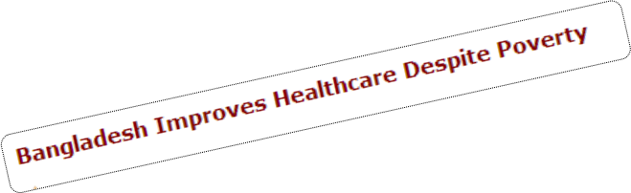

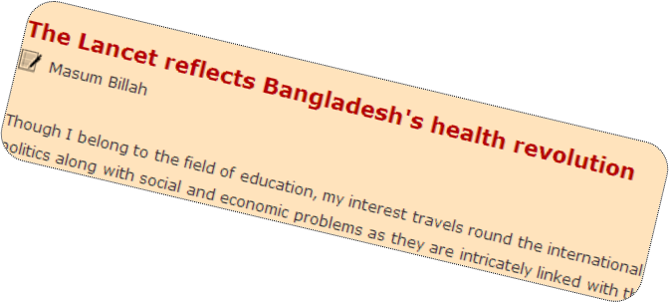
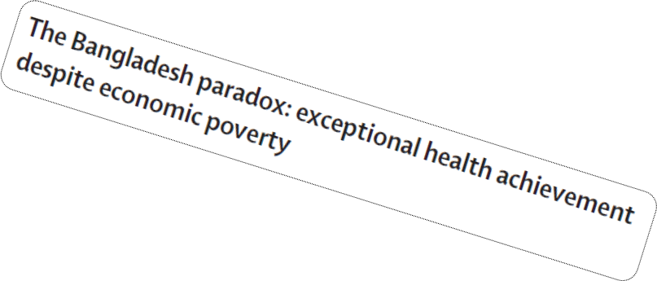

Health Sector of Bangladesh
A Story of Achievements
Bangladesh over the years have achieved remarkable progress
Through the government agenda the country had been on track with the MDGs
The country has the highest EPI coverage (82%) amongst neighboring countries

Slide 5
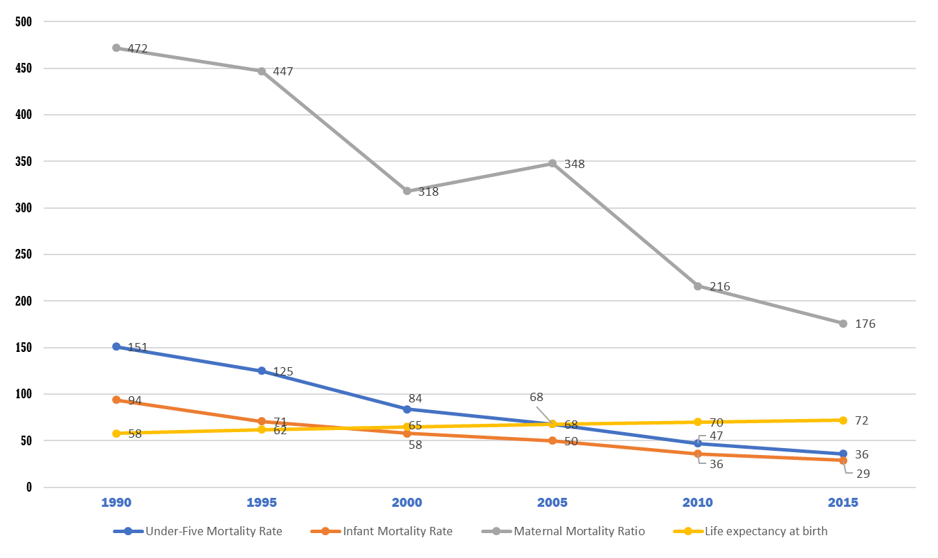
Reduced Mortality and Increased Life Expectancy
(Source: BDHS; BBS; H Bulletin; WB; MDG: End-Period Stocktaking and Final Evaluation (2000-2015) by GED, Planning Commission, GoB)

Slide 6
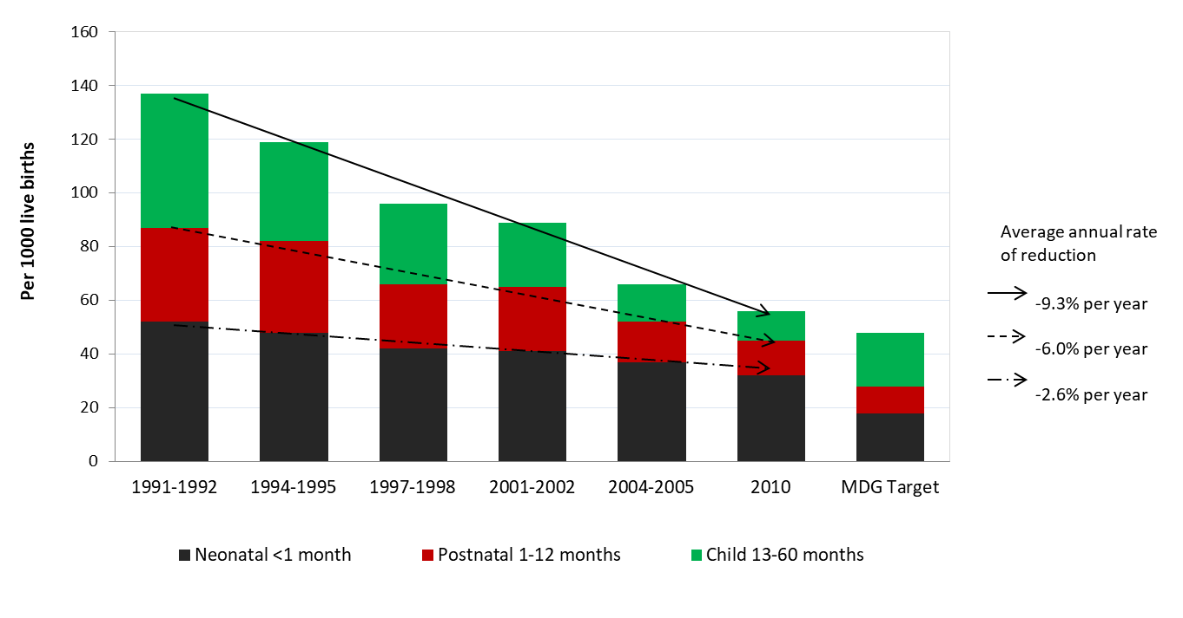
Progressive improvement in child health over the years
Sources: Measure DHS- Demographic and Health Survey URL: http://www.statcompiler.com/

Slide 7
Health Care Financing Features
We have a HCF system as part of the national financial management system.
Main Features
  Share in the national budget --- 5.2% (2017-2018) > 4.7 %
  Allocation for the health sector has increased by 39.18% over that of RBFY17
  6.2% of Total ADP which is higher than 4.4% (previous year)
  Per capita Health expenditure---US$ 37 (2015)¹
  Out-of-pocket---67% of Total health expenditure (THE) (2015)²
  Coverage of insurance --- <1% of THE (2015)²
  Government is financer and provider of services
  Budget norms follow civil service and budgetary regulations and codes.

Slide 8
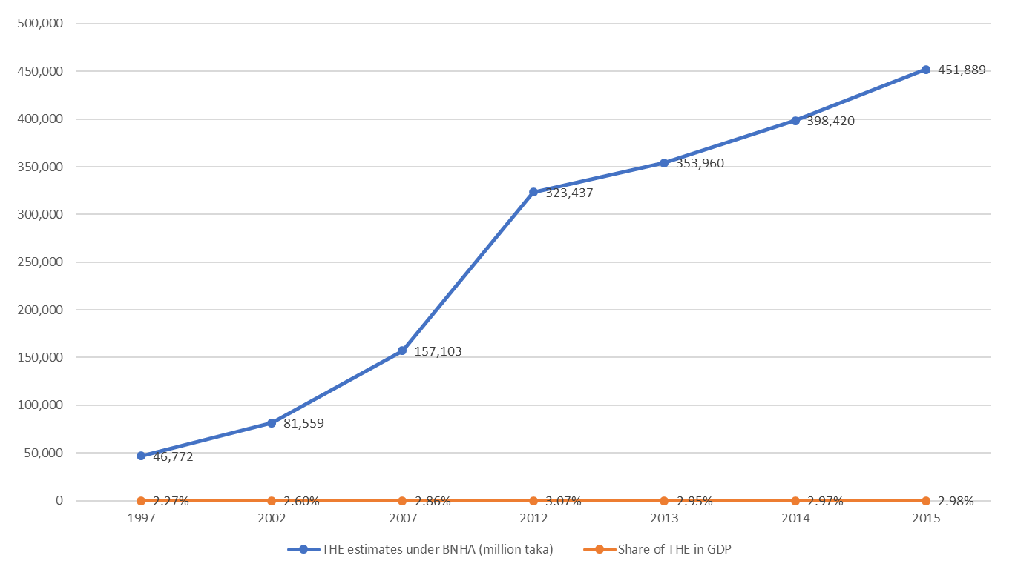
THE Estimates BNHA 1997-2015

Slide 9
Per capita THE during 1997-2015 grew around 6% annually in real terms
Year | Per capita THE (Current and constant price using 2015 as base year)
 | Current Taka | Constant Taka | Current (US $) | Real growth rate (%)
1997 | 382 | 1,083 | $ 09
2002 | 615 | 1,384 | $ 11 | 7.1
2007 | 1,105 | 1,907 | $ 16 | 6.4
2012 | 2,156 | 2,585 | $ 27 | 2.4
2013 | 2,318 | 2,593 | $ 29 | 0.3
2014 | 2,575 | 2,727 | $ 22 | 5.1
2015 | 2,882 | 2,882 | $ 37 | 5.7
Average
1998-2002 | 503 | 1,208 | $10 | 6.0
2003-2007 | 859 | 1,639 | $14 | 6.7
2008-2012 | 1,694 | 2,324 | $ 23 | 6.3
2013-2015 | 2,592 | 2,734 | $ 33 | 3.7
1998-2015 | 1,281 | 1,892 | $ 18 | 5.9

Slide 10
Per capita THE in 2015 increased to US$ 37 in 2015 from US$ 27 in 2012
Year | THE (BNHA 1997-2015)
 | Current (Taka) | Current (US $) | Purchasing Power Parity (PPP) Taka | Purchasing Power Parity (PPP) $
1997 | 382 | $ 09 | 1,115 | $ 26
2002 | 615 | $ 11 | 2,181 | $ 38
2007 | 1,105 | $ 16 | 4,131 | $ 60
2012 | 2,156 | $ 27 | 6,936 | $ 88
2013 | 2,318 | $ 29 | 7,146 | $ 89
2014 | 2,575 | $ 22 | 7,437 | $ 96
2015 | 2,882 | $ 37 | 7,936 | $ 102

Slide 11
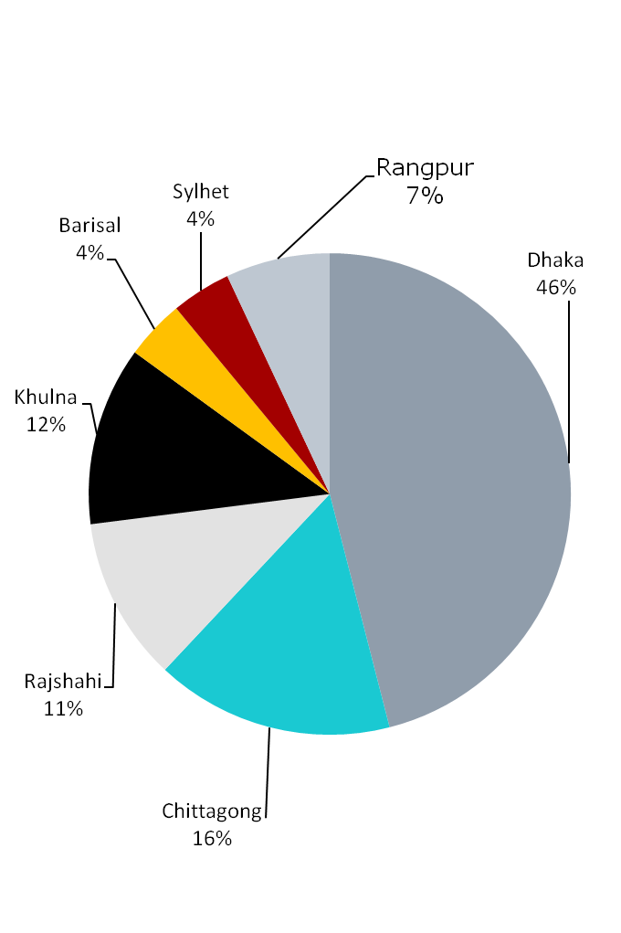
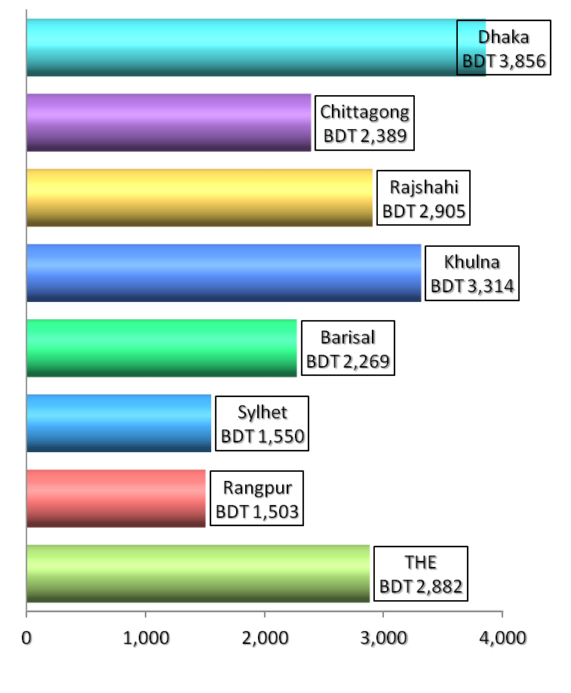
THE per capita by Division 2015
Share of THE by Division 2015

Slide 12
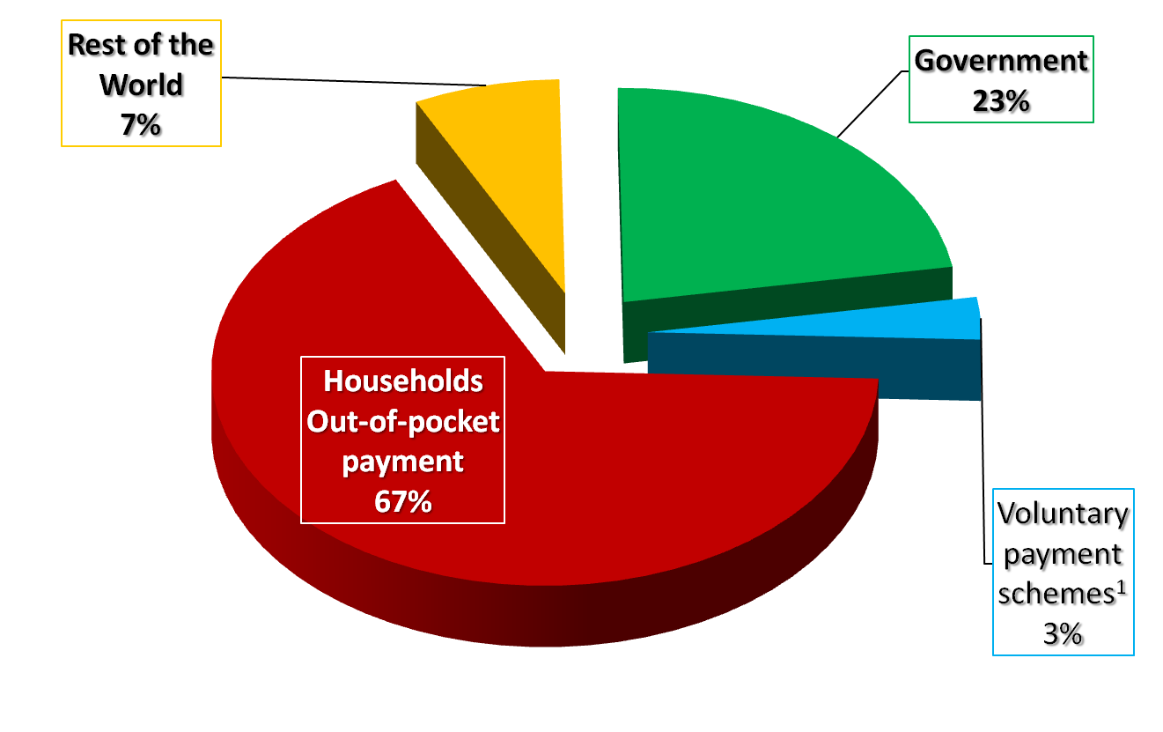
OOPS as a share of THE increased to 67% in 2015 while public share remained the same
¹ Voluntary health insurance, NIPISH/NGO,
Corporations-autonomous bodies-private companies

Slide 13
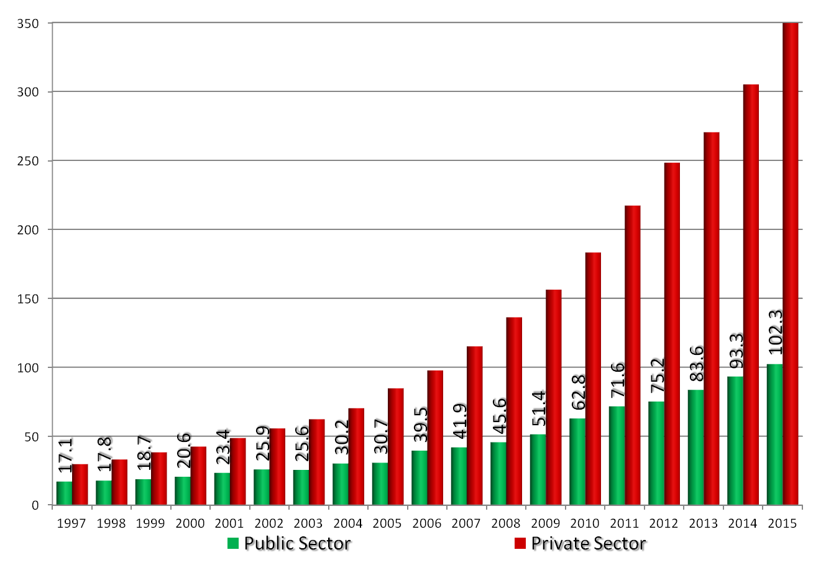
Public spending on health grew but at a slower pace than private spending during 1997-2015
Billion Taka
 | Public expenditure in nominal terms have increased every year

Slide 14
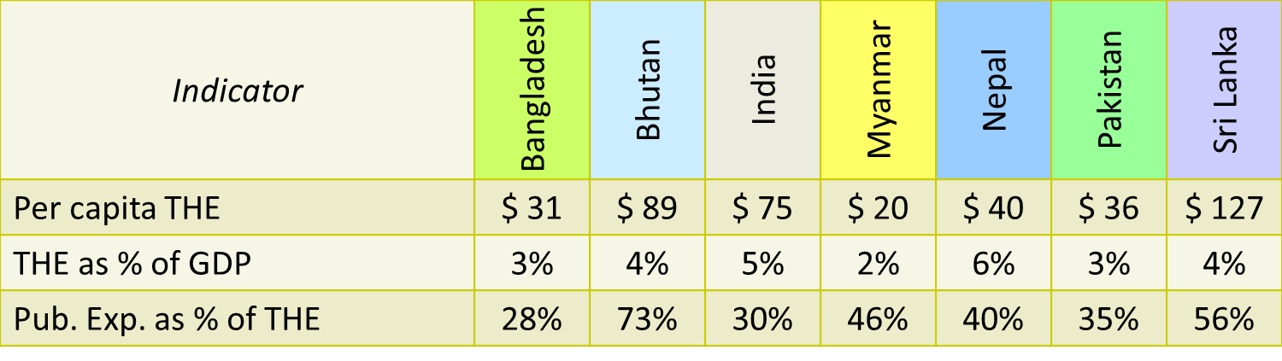
Regional comparison: 2014
Expenditure and selected Indicators
Life Expectancy at birth (yrs) | 72 | 69 | 68 | 66 | 68 | 66 | 75
Infant Mortality Rate | 32 | 28 | 39 | 41 | 31 | 67 | 09
Under 5 Mortality Rate | 40 | 34 | 50 | 52 | 31 | 83 | 10
Maternal Mortality Rate | 188 | 156 | 181 | 184 | 275 | 184 | 31
Source: World Bank

Slide 15
Bangladesh Steps toward UHC…
  Renewed Commitment through Health Policy 2011
  Revitalized and established nearly 13000 community clinics and improved hospital services
  Increased health manpower for hospitals and health centers to provide health care services
  Increased efficiencies in procurement, distribution and utilization of essential medicines and equipment
  Expanded demand side financing for ante-natal care and deliveries attended by skilled birth attendants
  Adoption of the HEALTH CARE FINANCING STRATEGY

Slide 16

Strategic document!

Slide 17
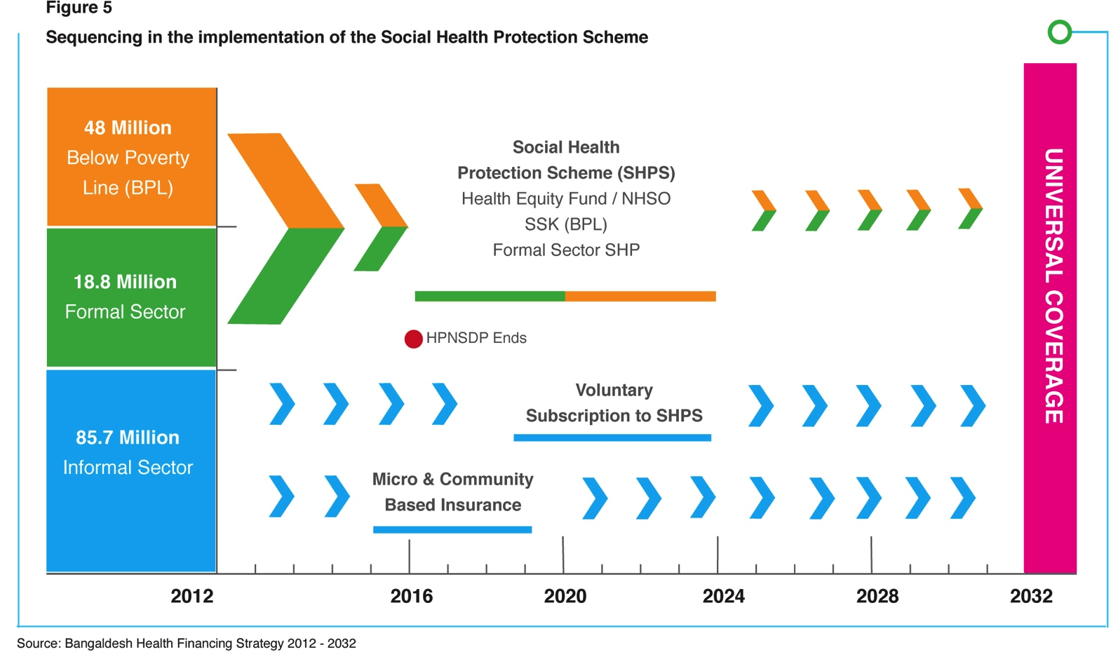
What is planned to attain “UHC”?

Slide 18

Strategic objectives
Health Care Financing Strategy 2012 – 2032 (HCFS 12-32)
Three strategic objectives:
Generate more resources for effective
health services
Improve equity and increase access especially
for the poor and vulnerable; and
Enhance efficiency in resource allocation and
utilization

Slide 19
Core Activities
(i) Design & implement Social Health Protection Scheme
Determine institutional arrangements for Social Health Protection Scheme
Design and implement National Health Security Office
Implement SSK for BPL
Design social health protection scheme for above poverty line .

Slide 20
Activities
Strengthen financing and provision of public health care services
Implement needs and performance based allocation
Scale up/Reinforce Results Based Financing
Retain User fees at point of collection

Slide 21
Activities
  Strengthen national capacity
Support information exchange platform/knowledge hub/resources pool
Develop the capacity to design and manage the social health protection scheme
Strengthen Financial Management and Accountability
Improve monitoring and evaluation
Introduce mechanisms to support the production of additional key staff (nurses, paramedics and medical technicians)

Slide 22
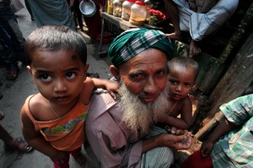
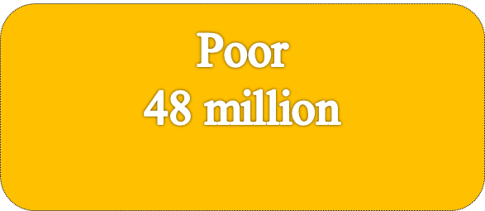
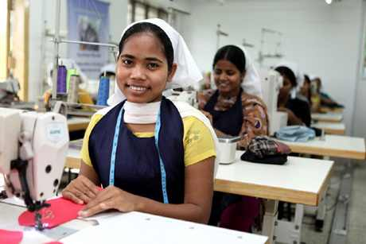

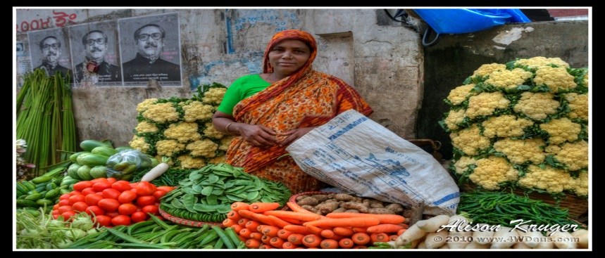

Who will benefit from UHC?

Slide 23
HCFS: Implementation status
Implementation status of interventions included in the Health Care Financing Strategy
MOHFW finalized design of SSK (GOB funded insurance for the poor) and initiated implementation of SSK in three upazilas
Package/Modality has been finalized for the Ready Made Garment Worker’s scheme
(a proposed social health protection scheme for population above poverty line)
Civil servants scheme: Feasibility study completed
(a proposed social health protection scheme for above poverty line)
Need based resource allocation formula has been approved by the MOHFW. Next step is approval of delegation of power to expense money at the facility level
The National Health Protection Act has been drafted, vetted by MOL and placed to the parliament and awaiting enactment

Slide 24
SSK: Background
2012: National Health Care Financing Strategy approved
2012: SSK Concept Paper developed
2013: SSK concept paper finalized and decided to pilot in three Upazillas( Sub districts) of Tangail district
2014: Benefit Package finalized ( 50 cases)
2014: Household survey completed in piloting facilities and finalized the data base for BPL( according to selection criteria)
2015: Green Delta Inc selected as Scheme Operator
2015: Contact with HHI for IT software
2015: SSK protocols has finalized for 50 cases ( DRG)
2016: 24th March: SSK Launched at Kalihati
2017: 12th September: SSK Launced in Ghatail & Modhupur

Slide 25
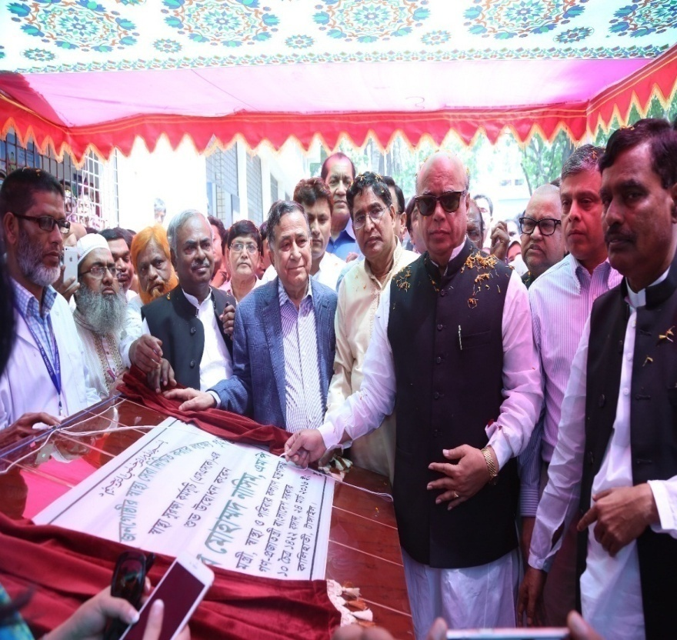
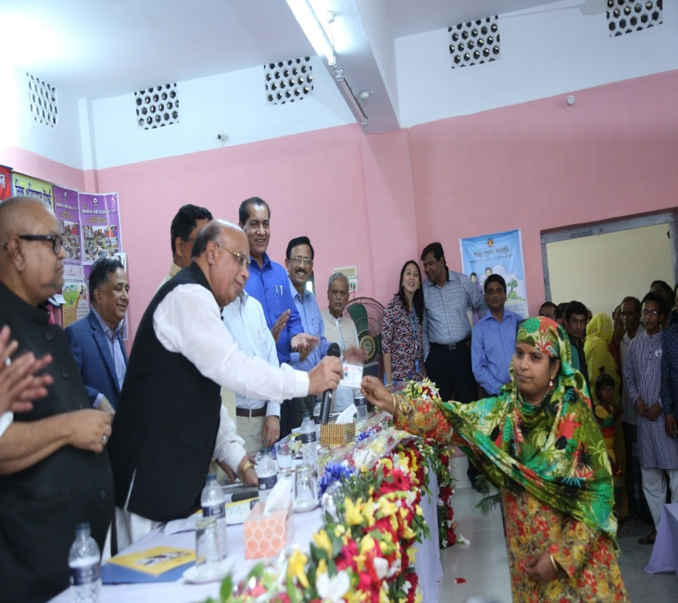
SSK

Slide 26
SSK: Introduction
SSK ( Shasthyo Surokhsha Karmasuchi) is a Social Health protection/ health financing scheme which is the step towards of Universal Health Coverage and first initiative of implementing the health care financing strategy developed by Health economics unit of MOHFW.

Slide 27
Guiding Principle for SSK
Universality
Equity
Non discrimination
Comprehensive care
Financial protection
Protection of Patient rights
Patient choice
Continuity of care
Consolidated and strengthening public health provisioning
Accountability and Transparency
Community Participation
Putting hands in peoples hand.

Slide 28
Guiding Principle for SSK:
The poor and vulnerable should be covered from the start – do not start with insurance for the formal sector and civil servants with the intention of bringing in the poor and informal sector later
Start by covering interventions against infectious diseases, targeting RNMCH, expanding to NCDs rapidly – the most highly cost-effective interventions
Limited if any payments at the point of service – poor and vulnerable exempted if fees are charged
Expand health services over time as rapidly as possible – prevention, promotion, treatment, rehabilitation, palliation

Slide 29
Guiding concept for SSK: contd.
  Voluntary insurance cannot get to UHC – at best, a supplement to compulsory pooling
  Catastrophic insurance – e.g. insurance for unpredictable high cost items such as inpatient care - cannot get to UHC

Slide 30
SSK :
Prepayment and pooling of resources - compulsory
Minimizing user fees and charges – zero for the poor and vulnerable (possibly "negative fees")
Good quality services are available
The combination of financial risk protection with the availability of good quality services – instrumental to increasing health and economic wellbeing, but also valued for its own sake

Slide 31
Dimension of SSK
Component | Area | Remarks
Quality | Timely Integrated service Appropriate- Best clinical practice | Quality Dimension
Package | Need based | 78 case benefit package (DRG)
Financial Protection | Free care Affordable care Payment at risk
Coverage for all | BPL household

Slide 32
To Achieve UHC: SSK will focus
Access to the poor
Financial risk protection
Quality of Care
Increase the authority at hospital level for functional improvement
Reduce OOP

Slide 33
SSK : Objectives
To Improve access of the poor to hospital inpatient care by reducing financial barriers;
To decentralize autonomous hospital activities for functional improvement in the health sector in phases
To develop of Local Level Planning (LLP).
To develop Partial financial autonomy
To Introduce performance based financing models
Introduce modern Information and Communication Technologies for increased efficiency and transparency in the health sector (e. g. claims processing, accounting, controlling, and electronic patient records).

Slide 34
SSK : Indicators
Number of BPL families enrolled
Number of SSK Patients admissions per UHC
Number of claims processed per UHC
Frequency of diagnosis as per DRG per UHC
Average life expectancy among members
OOP

Slide 35
SSK: Output
Reduced out-of-pocket payment (OOP) of the poor;
Increased access by the poor to hospital in-patient services;
Experience with a third party payer agency to manage the insurance fund;
Defined quality standards;
Improved efficiency and transparency in hospital management.

Slide 36
SSK: Elements
Administration ( SSK cell & Scheme operator)
SSK membership
SSK Management Committee
Benefit Package
Health Card
SSK IT
Quality Improvement

Slide 37
SSK: Supporting structure
SSK Cell
Scheme Operator
SSK Management Committee
3 SSK kiosk in 3 Upazillas and 1 kiosk in DH
SSK Medicine store( 3 piloting facilities)
Outsourced Staff (3 UHC): Cleaner & Security staff

Slide 38
SSK : Challenges
HRH ( Shortage Leadership/Motivation)
Inclusion of OPD in benefit package !
Empanelment of Private health facilities!
Introduction of P4P!

Slide 39
SSK: Status
SSK Information at Kalihati, Ghatail and Madhupur Upazila
Sl. No | Particulars | Reporting date |  |  |  | Cumulative (From opening to till date)
 |  | 22.7.2018 |  |  |  | Kalihati ( From 27.3.2016) | Ghatail (From 14.9.2017) | Madhupur (From 18.9.2017) | Remarks/ Cumulative
 |  | Kalihati | Ghatail | Madhupur | Tangail District hospital
1 | No. of SSK OPDs treated | 40 | 35 | 56 |  | 11,009 | 3850 | 7065
2 | No. of SSK IPDs admitted | 9 | 9 | 8 | 1 | 1636 | 635 | 783
3 | No. of SSK IPDs release | 6 | 4 | 3 | 1 | 1614 | 616 | 764
4 | No. of SSK IPDs refereed | 1 | 2 | 5 | 0 | 195 | 133 | 249
5 | No. of SSK IPDs absconded | 0 | 0 | 0 | 0 | 3 | 1 | 0
6 | No. of SSK IPDs in hospital | 22 | 19 | 19 | 8( K:0, G:3, M:5)
7 | Enrollment |  | 0 | 0 |  | 27533 | 27,151 | 25,985 | 53, 136
 | Card Distribution |  | 0 | 0 |  |  | 23,968 | 22,329 | 46,297

Slide 40
Next Steps!!
Inclusion of OPD in benefit package for SSK
Empanelment of Private sector
Revision of benefit package
End line Evaluation of SSK
Extension of 10 UHC from 2020
Health Insurance Scheme of RMG
Piloting for Resource Allocation Formula(RAF)
Social Health Protection Act
Formation of NHSO
Civil Servant Scheme!

Slide 41


